Slide 1

GEOG0113 Lecture 009 Phenology
P. Lewis
UCL Geography
& NERC NCEO

Slide 2
Aims of lecture
In this lecture, we will consider:
Phenology concepts
Phenology models

Slide 3
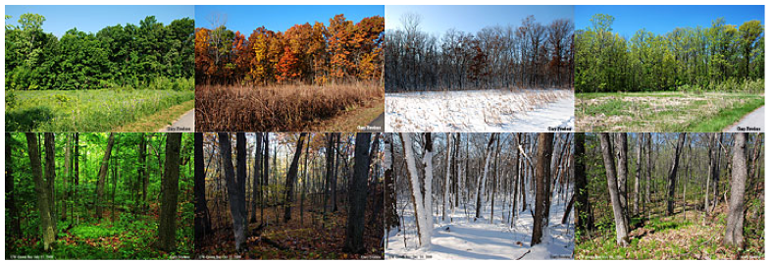
Phenology

Slide 4
Phenology
plants experience daily and seasonal variations in environmental conditions.
tend to adjust their behaviour to these variations.
diurnal variations in light, temperature and water.
Many plants then exhibit cirdadian rhythms (24 hour cycles) for example in stomatal opening

Slide 5
Phenology
temperate climate plants: strong seasonal variations in environment (but also some tropical – wet/dry seasons)
generally exhibit a predictable pattern of phenology
put more resources into leaf production at certain times, flowers at others etc.
E.g. leaf senescence timing from photoperiod
Cues onset of winter
shift resources (nutrients, carbohydrates, water) from leaves to other organs to prevent their loss from the plant
Notes:
Photoperiod: proportion of day to night

Slide 6
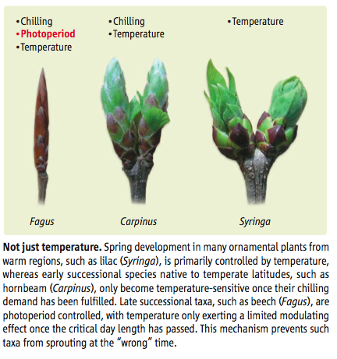
Extratropics (outside tropics)
Photoperiod same in winter and autumn,
plants need a cue that winter is over.
This is often obtained from the dose of low T … a ‘chilling’ requirement by some plants before spring bud burst

Slide 7
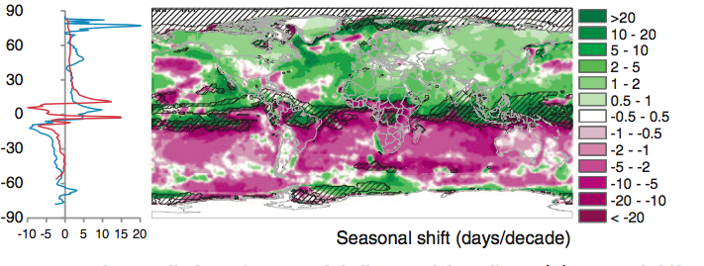
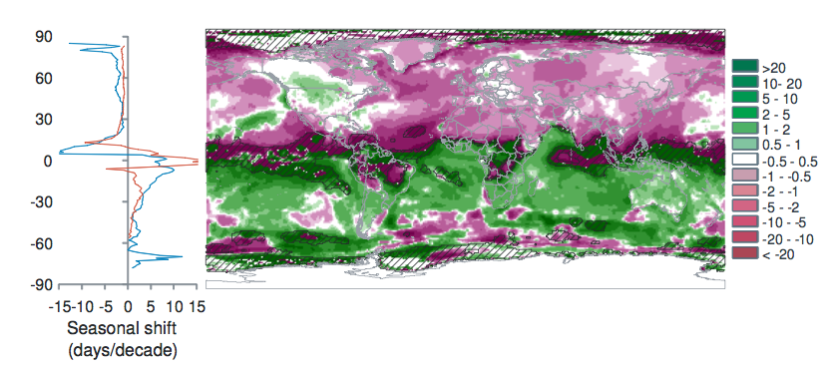
Spring Temp.
Seasonal shift in temp. 1960-2009
AutumnTemp.
Notes:
Burrows et al. 2011 analysed global temperature trends over the period 1960-2009 and have noted the following patterns of advance in Spring temperatures and delay in autumn temperatures.
“Seasonal shift (days/decade) is the change in timing of monthly temperatures, shown for April (top), representing Northern Hemisphere spring and Southern Hemisphere fall and October (bottom): positive where timing advances, negative where timing is delayed. Cross-hatching shows areas with small seasonal temperature change (<0.2 C/month), where seasonal shifts may be large.” Source: Burrows et al. 2011

Slide 8
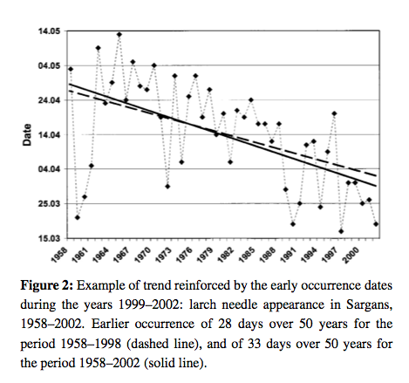
phenology
Notes:
Plant responses to such climatic variables means that phenology is likely to change under climate change, and there is already much evidence for this.
Our evidence for phenological changes comes from a combination of ground observations of this sort, flux towers, and satellite observations.
Until relatively recently there has been little work linking these two sources of information, partly due to a spatial paucity of ground data until recent years and partly because of complexities in matching the scales of the observations (Liang et al., 2011; Studer et al., 2007; White et al., 2009).

Slide 9
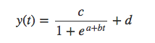
Models of phenology
Simplest: logistic fn of time
e.g. Zhang et al., 2003 MODIS phenology

Slide 10
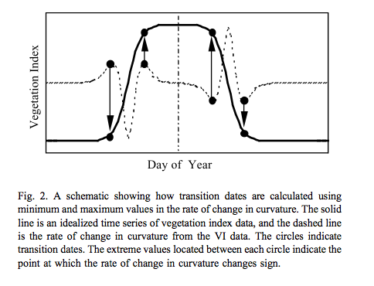
Track features of phenology

Slide 11
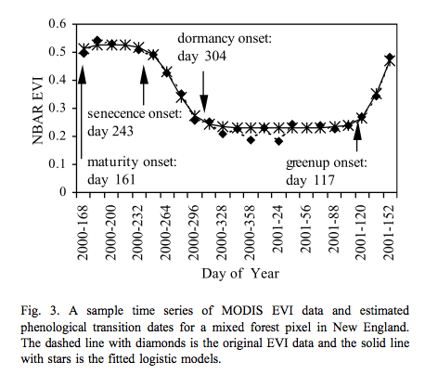
Track features of phenology

Slide 12
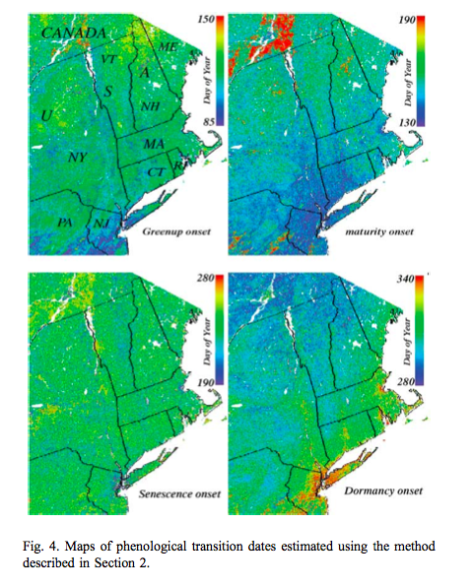
Such processing provides valuable spatial datasets of information related to phenology and allows the tracking of dynamics of the phenology metrics over time.
model of this sort is used to derive data that are then used to model phenology.

Slide 13
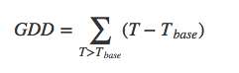
(Growing) Degree day model
simplest form of model that can be used prognostically
only really appropriate where temperature is a limiting factor in plant growth (the extratopics).
identify some threshold value of GDD F∗ that corresponds to the metric of interest.
So essentially 2 parameters (Tbase & F*)

Slide 14
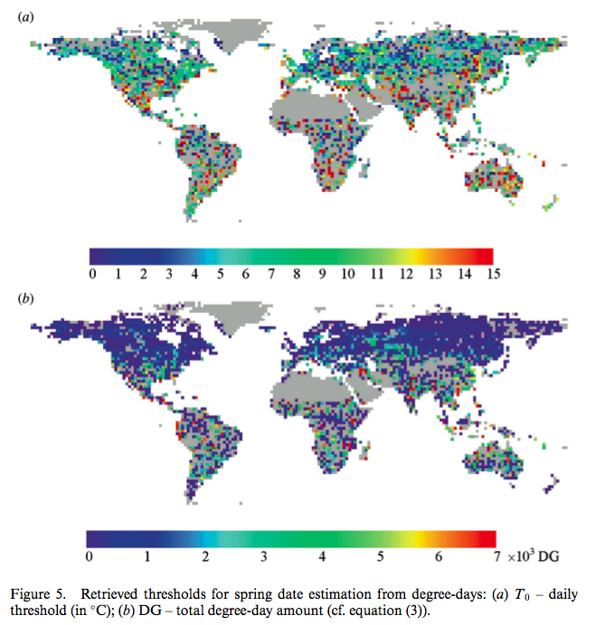
Sobrino et al. (2011) Int. J. Remote Sens., 32, 5247–5265.
BUT many papers on this eg see Rodriguez‐Galiano et al. (2016) Intercomparison of satellite sensor land surface phenology and ground phenology in Europe, GRL,42 (7), 2253-2260
Notes:
e.g. Sobrino et al 2011 double logistic function of the same form for mapping changes in spring date timing trends for global vegetation from avhrr

Slide 15
Model calibration
Take data (e.g. satellite VI) and T dataset
Extract phenology metric (e.g. bud burst) from VI
Work out which Tbase & F* give best fit to this
Over long time series per location
Or assuming parameters constant spatially

Slide 16
Chilling
Can incorporate chilling:
sequential models:
forcing only starts when the chilling requirement is met
parallel models:
chilling and forcing accumulated in parallel and critical values then applied to both
alternating models:
the temperature F∗ is a decreasing function of chilling.

Slide 17
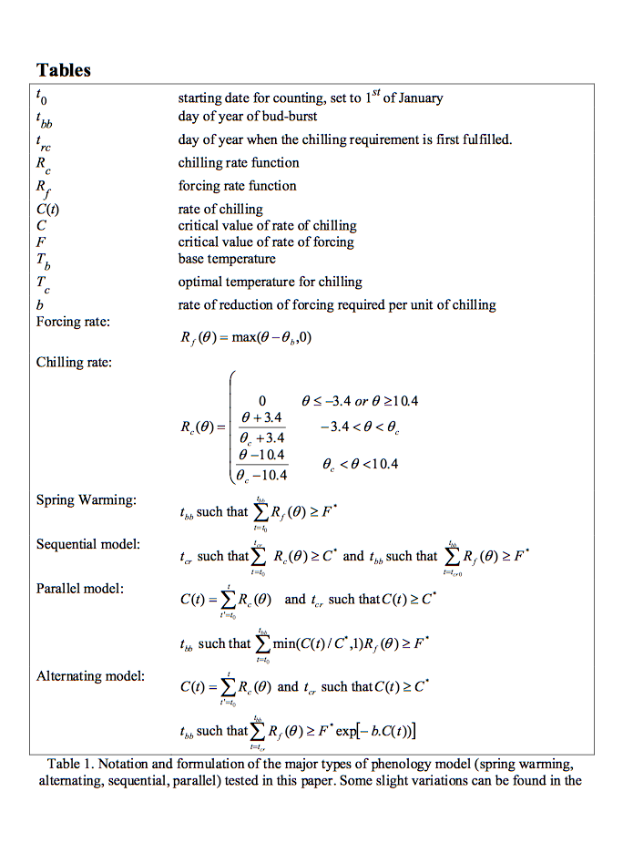
Picard et al. (2005) use NDWI to track chilling for Siberia
Use to calibrate DVGM

Slide 18
tropics
simulating and understanding phenology is complicated
Mainly water constraint
But complicated as not just dept. on precipitation
Plants may have deep or shallow roots
The state of phenology models in DGVMs for tropical areas then is at present rather weak and an area of active research.

Slide 19
Summary
Phenology important concept in monitoring, modelling and understanding vegetation dynamics and its response to climate variations.
growing amount of observational data on phenology at various scales and more recent attempts to reconcile measures at different scales.
likely that for some areas at least, species specific (or slighly broader groupings of species) parameterisations of phenology need to be considered rather than just broad PFT definitions.
Most phenology analysis is done using simple degree day models, although some analyses also consider chilling requirements.
Phenology models in DGVMs may be phrased rather differently to those used in most analyses. Whilst maintaining a required ‘mechanistic approach’, current DGVM phenology models are not entirely satisfactory.

Slide 20
Recommended Reading
Bradley et al. 2011, Relationships between phenology, radiation and precipitation in the Amazon region, Global Change Biology Volume 17, Issue 6, pages 2245-2260, June 2011
White, M. A., et al. (2009), Intercomparison, interpretation, and assessment of spring phenology in North America estimated from remote sensing for 1982-2006, Glob. Change Biol., 15(10), 2335-2359.
Studer, S. ; Stockli, R. ; Appenzeller, C. ; Vidale, P. ; Vidale, L. 2007, A comparative study of satellite and ground-based phenology , International Journal of Biometeorology, 2007, Vol.51(5), p.405-414
Sobrino, JA., Yves Julien, Luis Morales, 2011, Changes in vegetation spring dates in the second half of the twentieth century, International Journal of Remote Sensing , Vol. 32, Iss. 18, 2011
Schwartz, M.D and Hanes J.M. 2010, Continental-scale phenology: warming and chilling, Int. J. Climatol. 30: 1595-1598 (2010)
Burrows, Michael T ; Schoeman, David S ; Buckley, Lauren B ; Moore, Pippa ; Poloczanska, Elvira S ; Brander, Keith M ; Brown, Chris ; Bruno, John F ; Duarte, Carlos M ; Halpern, Benjamin S ; Holding, Johnna ; Kappel, Carrie V ; Kiessling, Wolfgang ; O’Connor, Mary I ; Pandolfi, John M ; Parmesan, Camille ; Schwing, Franklin B ; Sydeman, William J ; Richardson, Anthony J, The pace of shifting climate in marine and terrestrial ecosystems, Science (New York, N.Y.), Nov, 2011, Vol.334(6056), p.652-5
Reed, at el., 2009. Remote Sensing Phenology: Status and the Way Forward, in Noormets, A. Phenology of Ecosystem Processes: Application in Global Change Research. Springer, Dordrecht, pp. 275.

Slide 21
Picard, G., Quegan, S., Delabert, N., Lomas, M.R., Le Toan, T., Woodward, F.I. (2005) Bud-burst modelling in Siberia and its impact on quantifying the carbon budget, Global Change Biology 11 (2005) 2164-2176
Jeffrey Morisette, Mark Schwartz (Lead Author);C Michael Hogan (Topic Editor) “Phenology” . In: Encyclopedia of Earth. Eds. Cutler J. Cleveland (Washington, D.C.: Environmental Information Coalition, National Council for Science and the Environment).
Liang, LA ; Schwartz, MD ; Fei, SL, 2011, Validating satellite phenology through intensive ground observation and landscape scaling in a mixed seasonal forest, Remote sensing of environment, 2011 JAN 17, Vol.115(1), p.143-157
Korner and Basler, 2010, Phenology Under Global Warming, Science 19 March 2010: 1461-1462.DOI:10.1126/science.1186473
Defilia and Clot, 2005, Phytophenological trends in the Swiss Alps, 1951-2002, Meteorologische Zeitschrift, Vol. 14, No. 2, 191-196 (April 2005)
Fisher, JI ; Richardson, AD ; Mustard, JF, 2007, Phenology model from surface meteorology does not capture satellite-based greenup estimations, lobal change biology, 2007 MAR, Vol.13(3), p.707-721
Zhang, X. Y., Friedl, M. A., Schaaf, C. B., Strahler, A. H., Hodges, J. C. F., Gao, F., et al. (2003). Monitoring vegetation phenology using MODIS. Remote Sensing of Environment, 84, 471-475.

